Slide 1
Properties
(Props) Stagecraft

Slide 2
Props
In almost every play you see they will be using some form of prop. These are the items that the characters pick up, use and interact with on stage. Sometimes they are already on stage, sometimes the actor brings them onstage when they enter.

Slide 3
Context
Depending on when and where the play is set, you could have multiple options for a certain prop.
Let’s look at an example: Jackie is sitting in her lounge room listening to music.

Slide 4
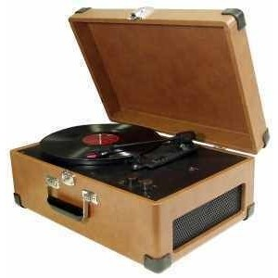
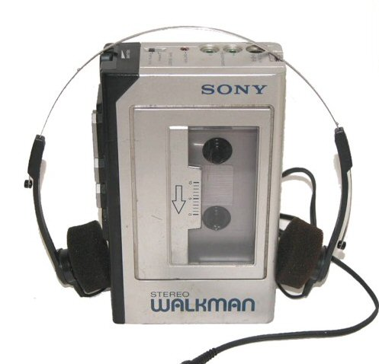
Context
1950’s:
1980’s:

Slide 5
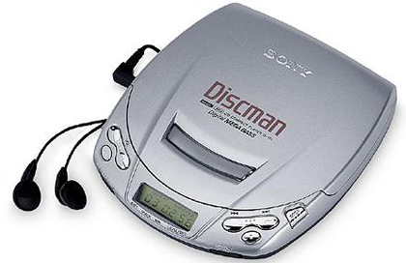
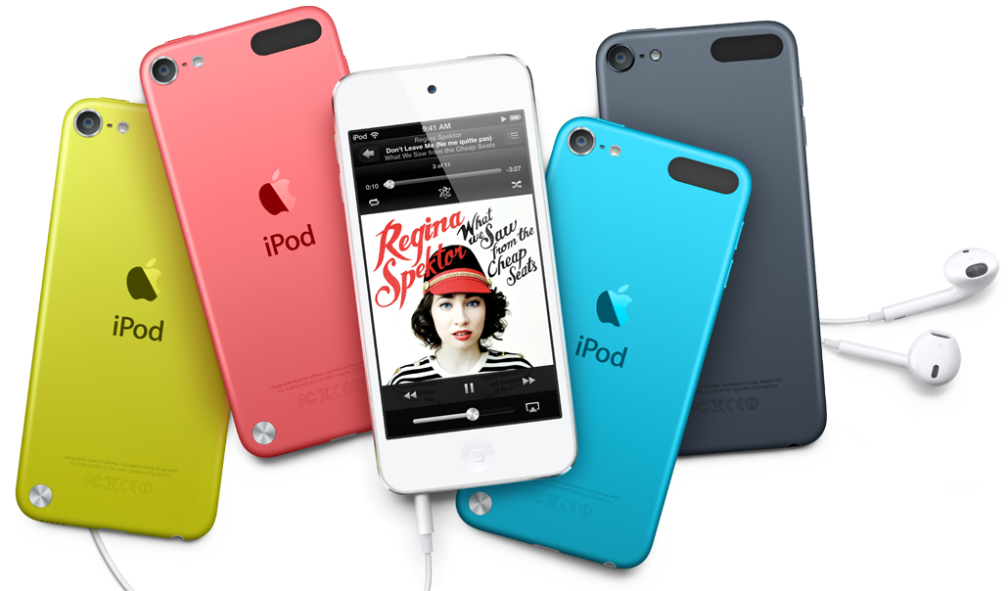
Conext
1990’s:
2010’s:

Slide 6
Context
Choosing a certain type of prop helps add to the context of the play as well as a characters personality. There is no reason why the character couldn’t be using a 1950’s record player in the 2000’s. This helps the audience better understand the character and the play.

Slide 7
Your Task
Firstly, you are to choose a chair.
Here are the stage directions:
Marcus is sitting in a chair waiting.

Slide 8
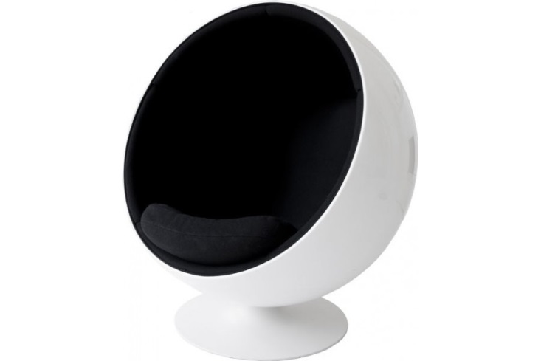
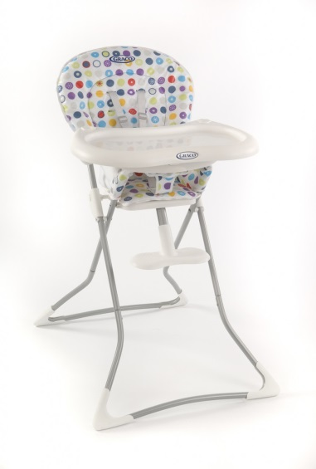
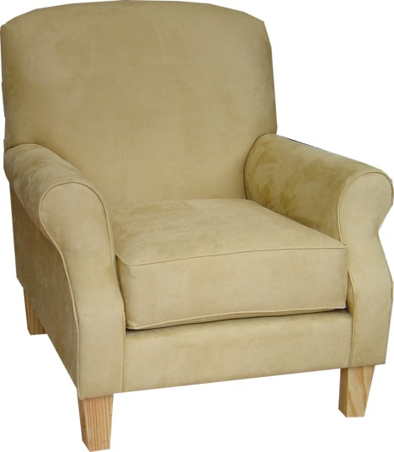
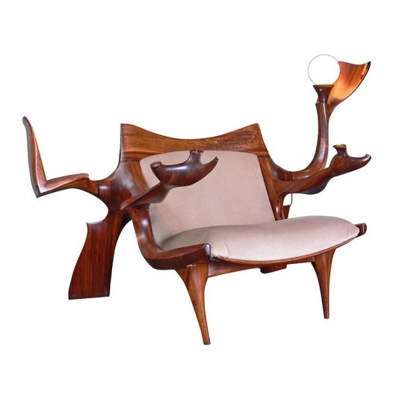
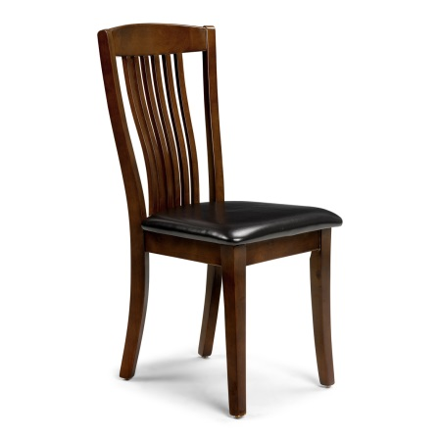
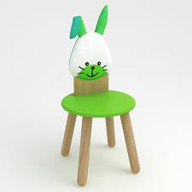
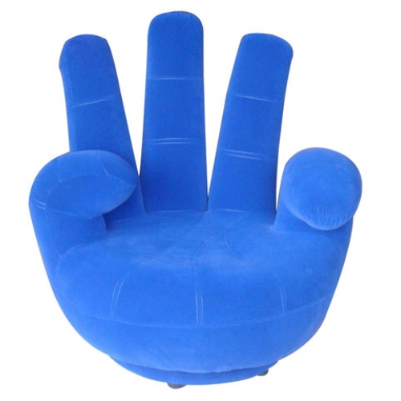
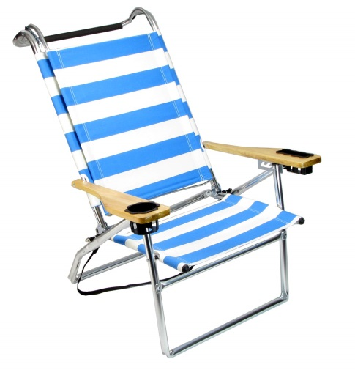
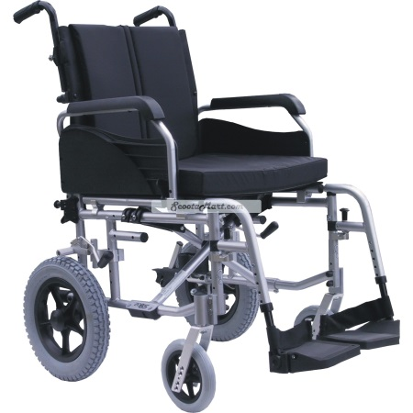

Slide 9
Your Task
After choosing a chair, write a short paragraph describing Marcus and why he is waiting.

Slide 10
Your Task
From a short set of stage directions you are to design the different props needed for the scene. It is up to you what the props look like, how old they are, what decade they are from etc. To begin you might like to choose a decade to set the play in and work from there.

Slide 11
Your Task
Natalie re-enters the stage. She is dressed up and ready for a night out with the girls. She has a bag over her shoulder and from it retrieves a mobile phone and begins to text. She is yet to notice that waiting for her is Nick. He is holding a broken wine bottle and there is a bunch of flowers on the table.

